Slide 1

SMART SUPPLY CHAIN FOR E-COMMERCE

Slide 2




TEAM-01
Jitendra Prasad Data Scientist
Sahithi Kantu Data Architect
Arshad Data Engineer
Durga Syamala Mareedu Data Analyst

Slide 3
BUSINESS QUESTIONS
How does the “time of day and seasonal factors influence browsing behavior,” such as product views and category preferences, as well as purchasing behavior?
How can we optimize supply chain operations
and enhance customer satisfaction by “strategically locating a new warehouse “based on customer order locations and profit margins?
How can we “optimize marketing investment for our E-commerce”
business while maximizing customer engagement and sales?
1
2
3

Slide 4
SUGGEST SOULTIONS
Optimize warehouse locations for cost savings, faster delivery, and profitability.
Improve supply chain efficiency to enhance customer satisfaction and gain competitive advantage.
Leverage time of day and seasonal trends to customize marketing and product strategies.
Analyze browsing and purchasing behaviors for targeted customer engagement and improved sales performance.
Develop a targeted notification system utilizing customer purchase history analysis to prioritize communication with active customers.
Streamline marketing efforts and reduce costs by focusing on personalized communication through unique customer IDs.
1
2
3

Slide 5
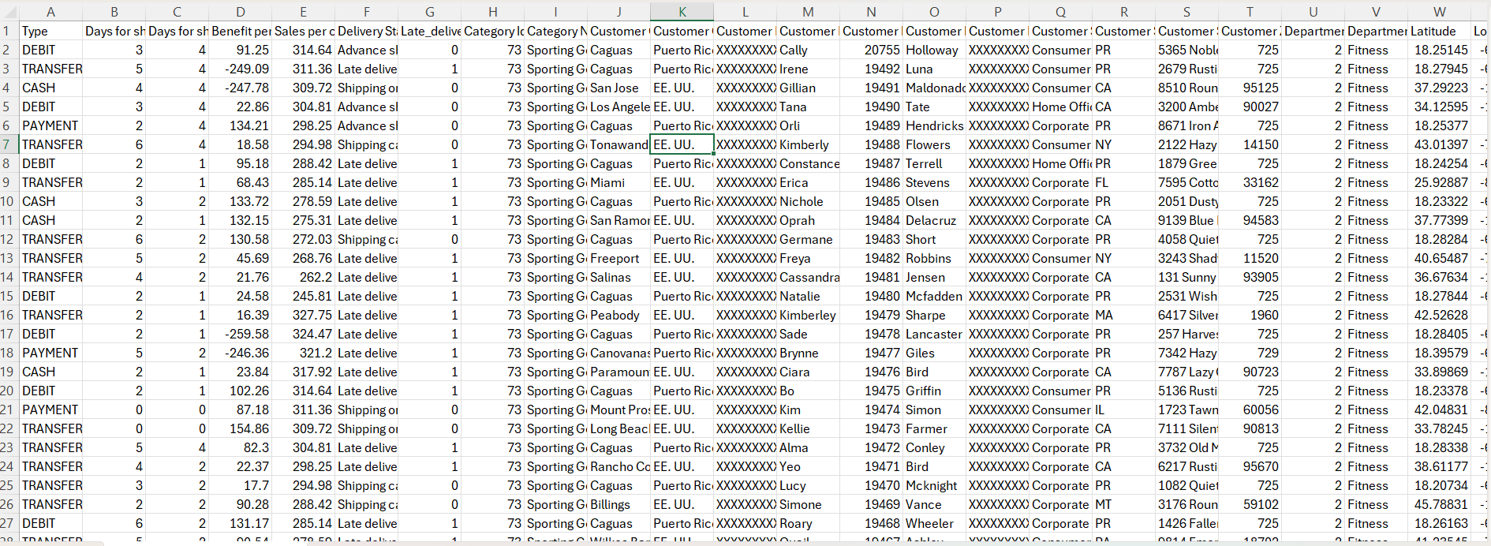
DATA SET OVERVIEW
DataCo SMART SUPPLY CHAIN FOR BIG DATA ANALYSIS SUPPLY CHAIN FOR BIG DATA ANALYSIS
The data set is extracted from Kaggle- https://www.kaggle.com/datasets/shashwatwork/dataco-smart-supply-chain-for-big-data-analysis/code
Data Overview: 93.27MB , 53 Columns ,180520 Rows

Slide 6
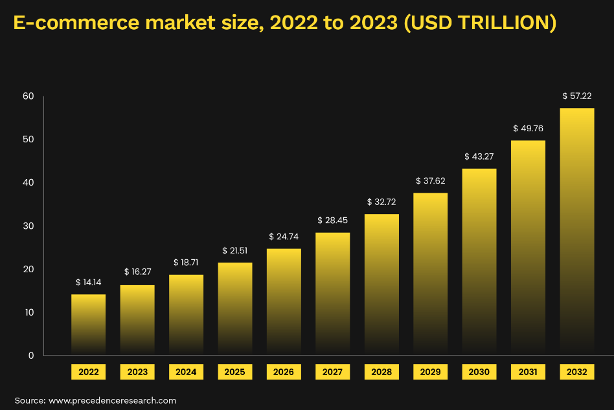
TOTAL MARKET SIZE
In 2023,2.64 billion individuals made online purchase.
Comprising 33.3% of the global population.
This represented an increase of 80 million digital buyers compared to 2022.
The year-over-year growth rate from 2022 to 2023 was 3.1%.

Slide 7
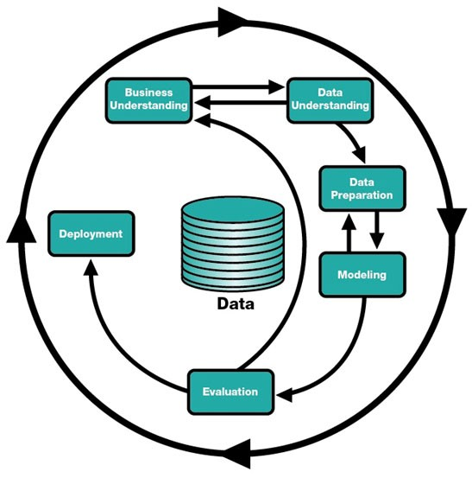
BUSINESS MODEL- CRISP DM METHODOLOGY

Slide 8









TECHNOLOGY / EXPERTISE
TECHNOLOGIES
WE ARE
GOING TO USE

Slide 9
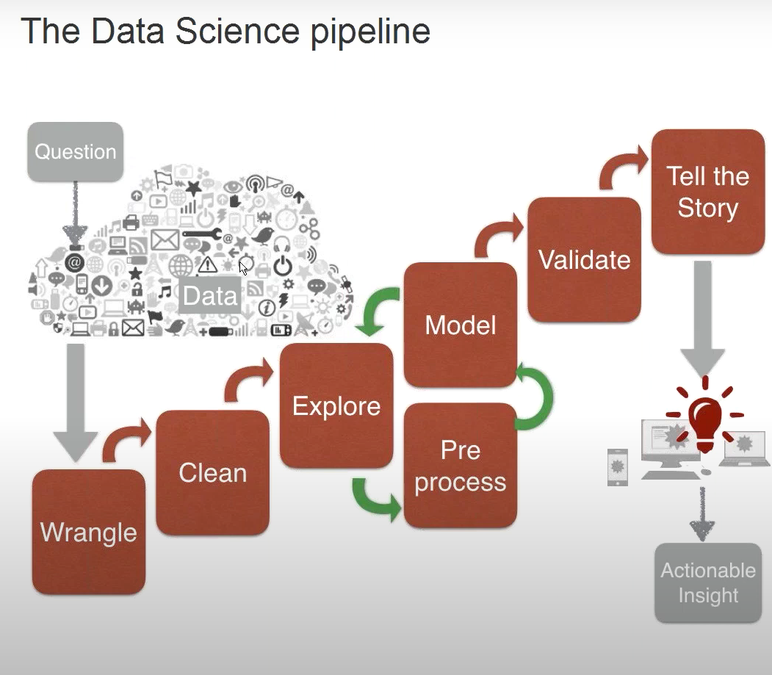
PROJECT PIPELINE
Ref: https://www.youtube.com/watch?app=desktop&v=cugl5t-W1sE

Slide 10
REFERANCES
DataCo SMART SUPPLY CHAIN FOR BIG DATA ANALYSIS (kaggle.com) - Dataset
Supply Chain Analytics Market Size & Forecast, [Latest] (marketsandmarkets.com) – Market Size
https://www.youtube.com/watch?app=desktop&v=cugl5t-W1sE – project pipeline
https://www.software.ac.uk/sites/default/files/images/content/jupyter-main-logo.svg
https://th.bing.com/th/id/OIP.b_al7C5p26tbZG4syCWqwHaFj?rs=1&pid=ImgDetMain
https://th.bing.com/th/id/OIP.EZlZtDh1zDbqQEw29IC58gHaEK?w=299&h=180&c=7&r=0&o=5&dpr=1.3&pid=1.7
https://th.bing.com/th/id/OIP.oIDIjIpWyoXnqSYvVd4xxQHaFP?rs=1&pid=ImgDetMain
https://th.bing.com/th/id/OIP.nUYOwBlsmc2xTLmGRzBTCQHaHa?rs=1&pid=ImgDetMain
https://www.qedgetech.com/wp-content/uploads/numpy.png
https://th.bing.com/th/id/OIP.zVWEBrr7MVxJaRNk8T9wdwHaC_?rs=1&pid=ImgDetMain
https://matplotlib.org/stable/_images/sphx_glr_logos2_003.png

Slide 11


